Slide 1
THESSALONIKI
MONUMENTS AND SIGNIFICANT PLACES

Slide 2
THE CITY’S CULTURE
Established in 316 BC by the Macedonian king Kassandros. Thessaloniki was named after Kassandros’ wife and sister of Alexander the Great. The second largest city of Greece has always been a crossroad of cultures, an important port with a pivotal geographical location, a city with a history that goes back deep into the centuries, composed by immigrants, locals, a mixture of people that left their mark in the architecture, the cuisine and the urban atmosphere.

Slide 3
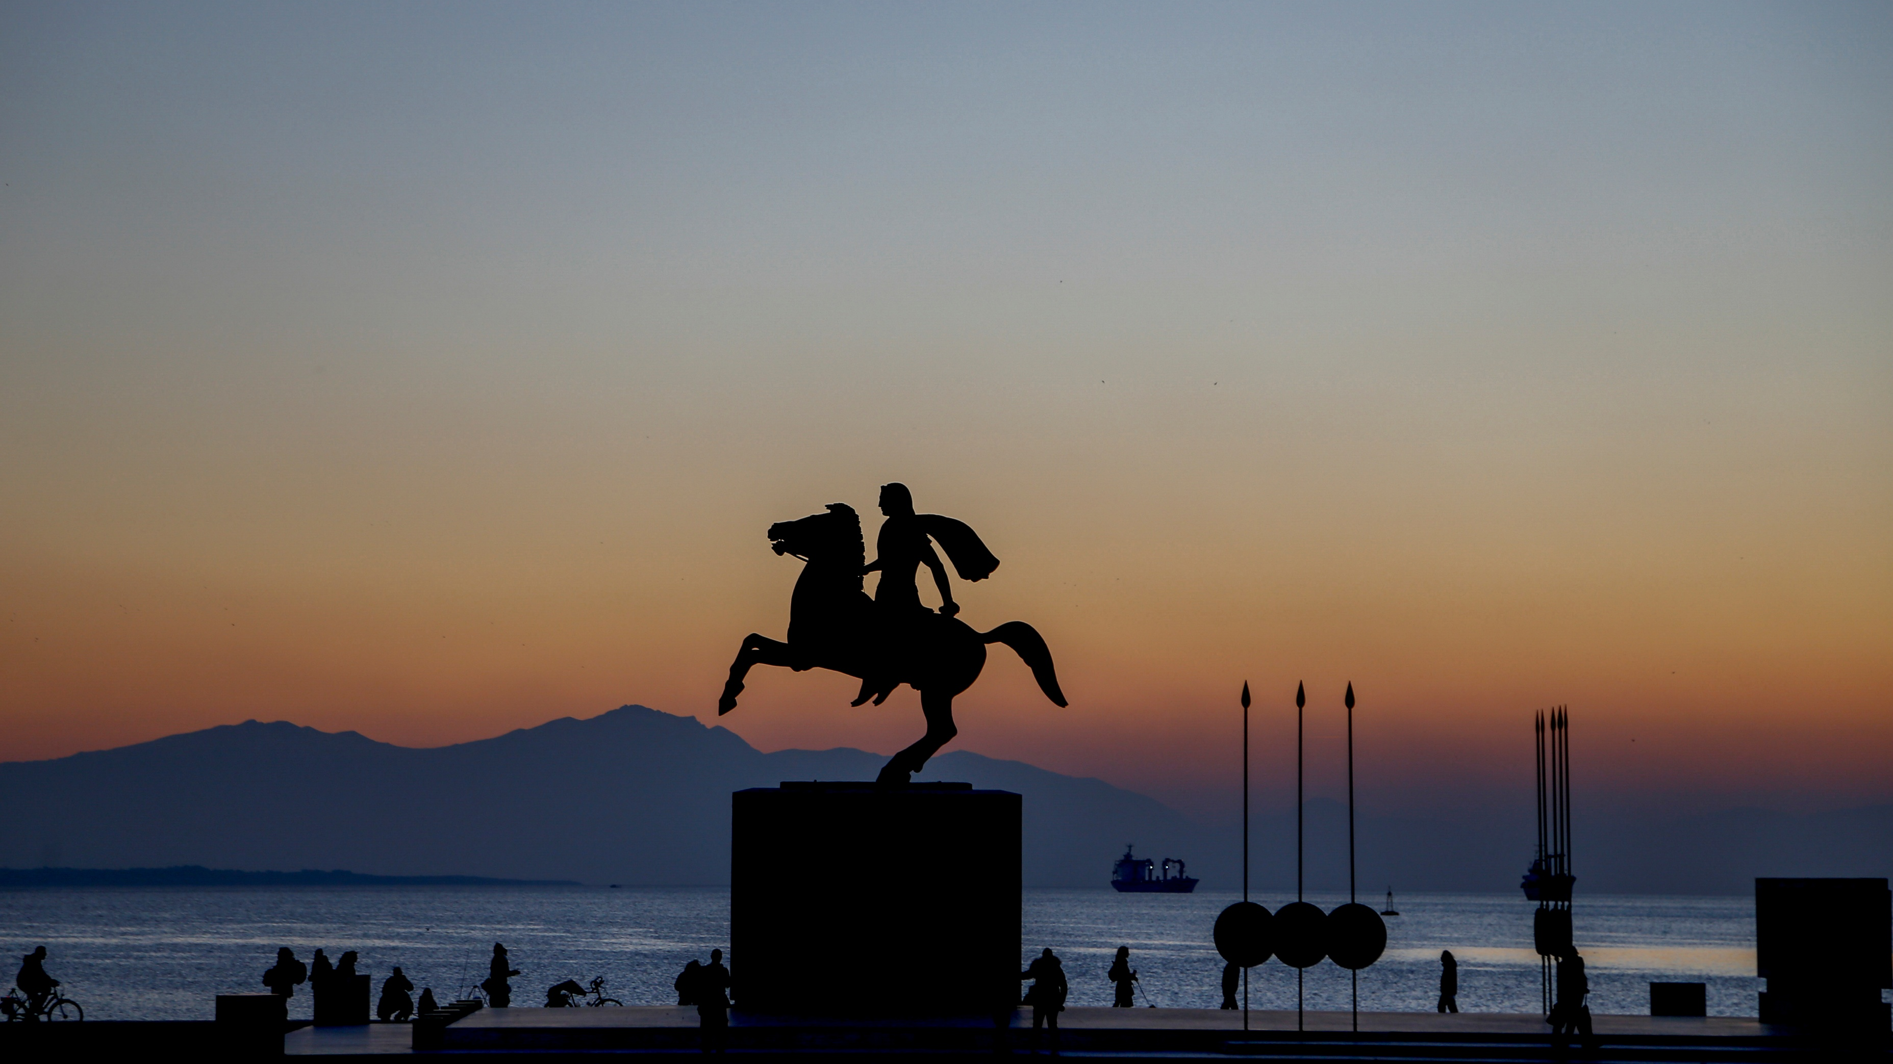

Slide 4
CHURCHES

Slide 5
Church of Agios Dimitrios
(Saint Demetrius)
One of the most important early Christian churches of Thessaloniki is dedicated to Agios Dimitrios (Saint Demetrius), the patron saint of the city. It is a building that dates from the 7th century and has been declared a world heritage site by UNESCO. Visitors can worship the relics of Saint Demetrius and every year on 26 October they can attend the litany and take part in the procession of the relics and the icon of the Saint in the streets of the city.

Slide 6
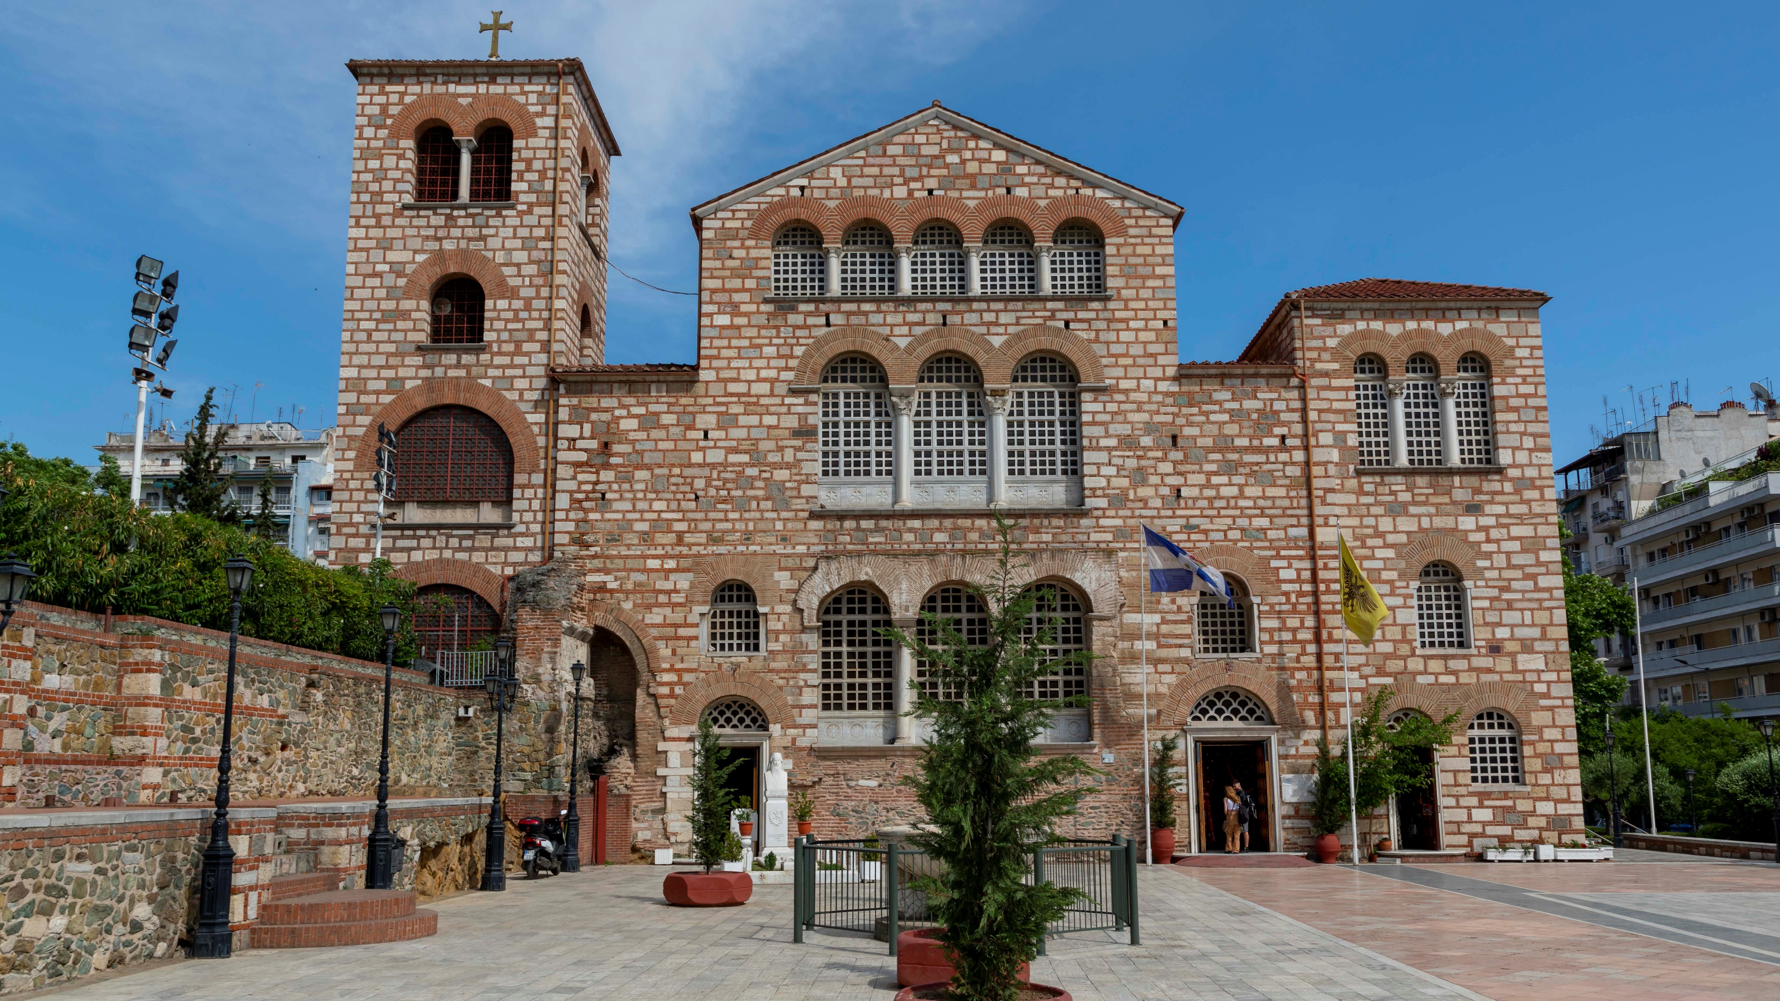

Slide 7
Church of Agia Sofia (Holy Wisdom)
Built at the end of the 7th century and imitating the structure of Hagia Sophia in Constantinople (present-day Istanbul, Turkey), the church has kept intact through time a huge mosaic depicting the Ascension of Jesus Christ in the interior of the central dome. It is one of the most beautiful Byzantine churches in Thessaloniki and a UNESCO monument of world cultural heritage.

Slide 8
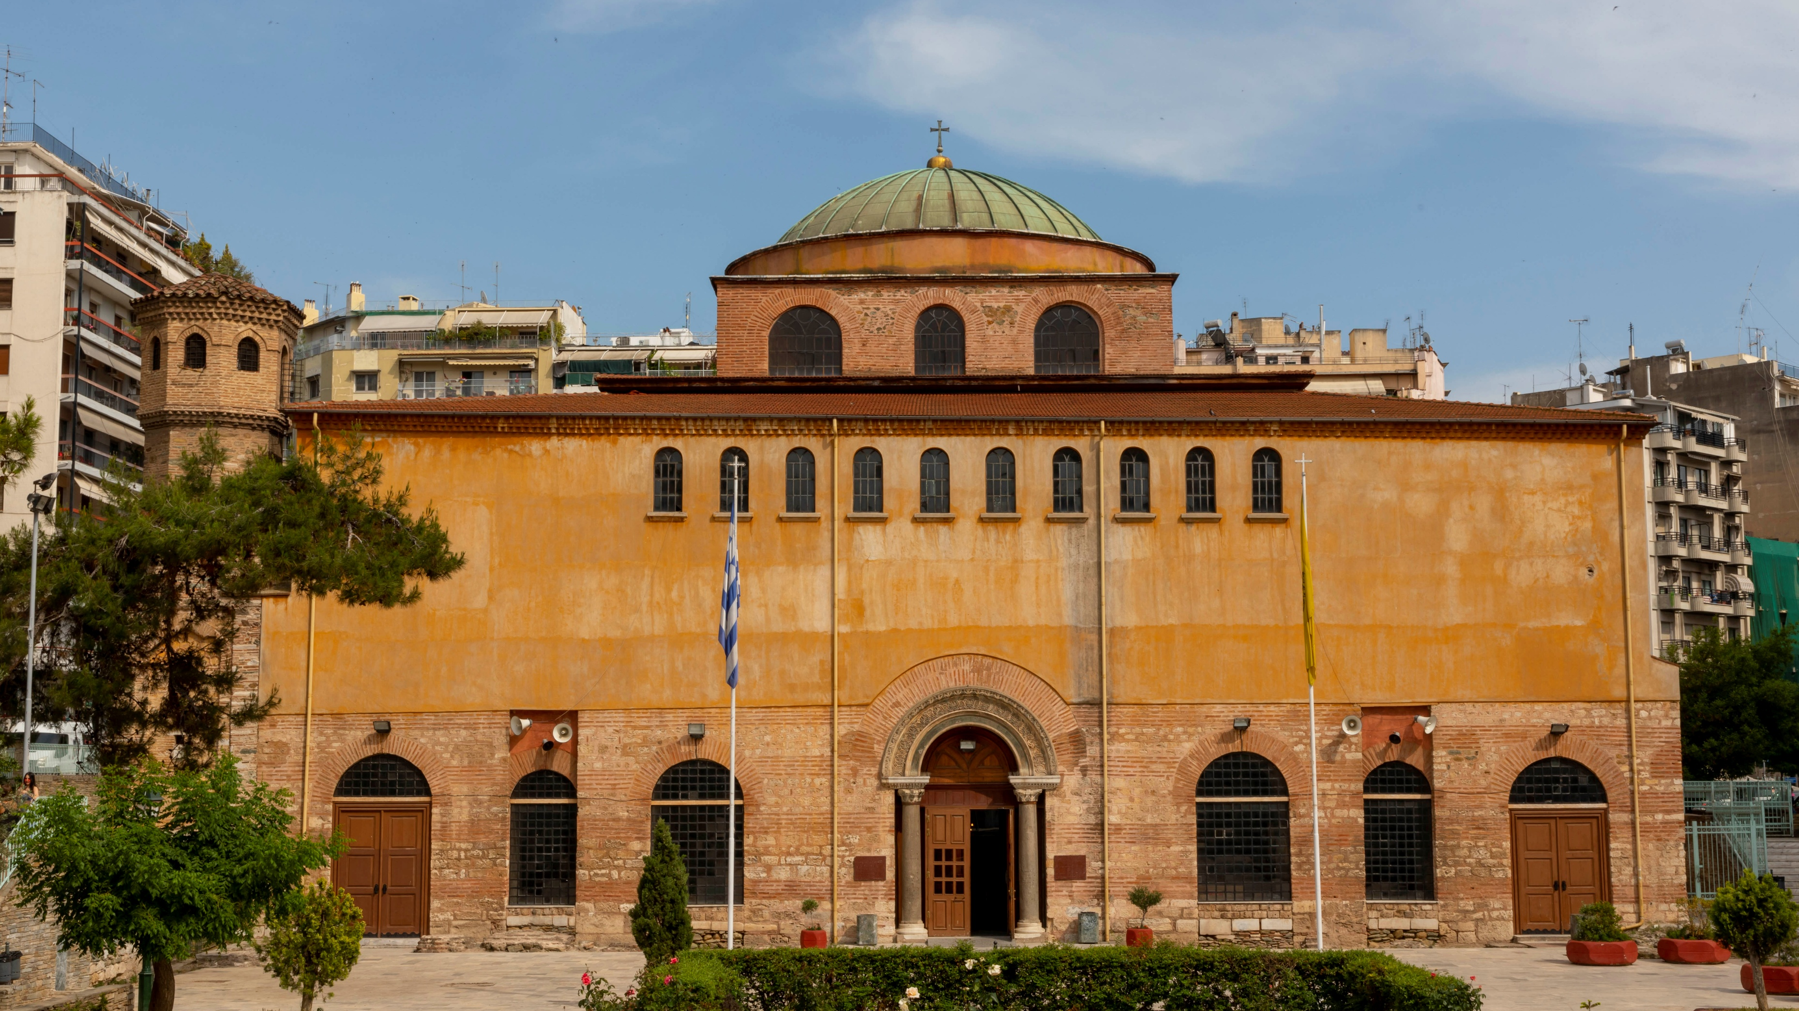

Slide 9
MONUMENTS AND OTHERS
Thessaloniki has 15 UNESCO monuments

Slide 10
White Tower
The symbol of Thessaloniki, the White Tower, was built in the 15th century and operated as a prison of long-term convicts and later as a military headquarters. Today, on its six floors there is a permanent exhibition that reflects the history of the city from its foundation in 316 BC up to this day.

Slide 11
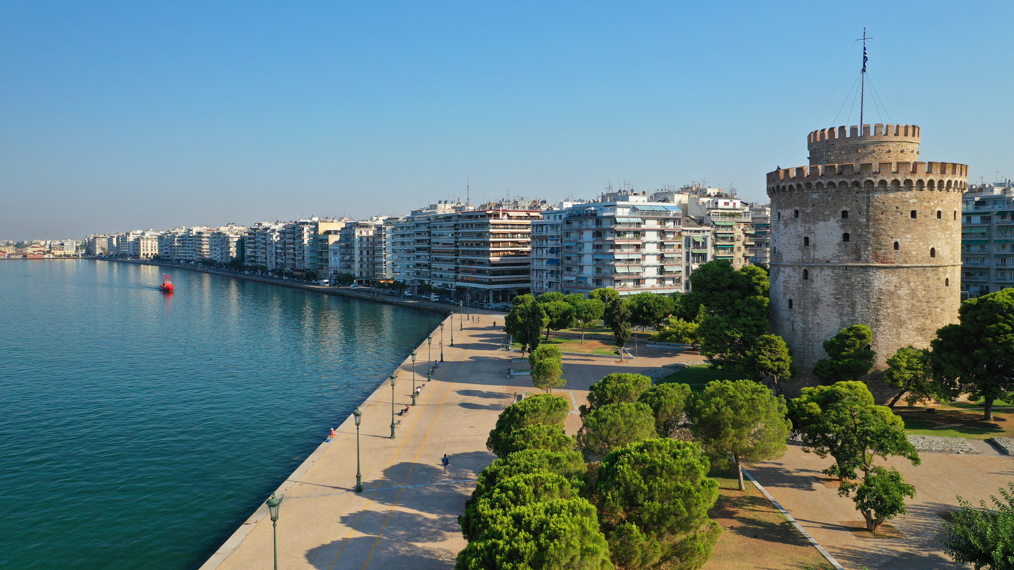

Slide 12
Known over the years with various names, «Tower of the Lion», «Tower of Kalamaria», as well as «Tower of the Janissaries» and «Tower of Blood» (Kanli Koule), when it became a prison and place of convicts’ execution. In 1831 , the Tower was whitewashed and given the name White (Beyaz Koule), its current name.

Slide 13
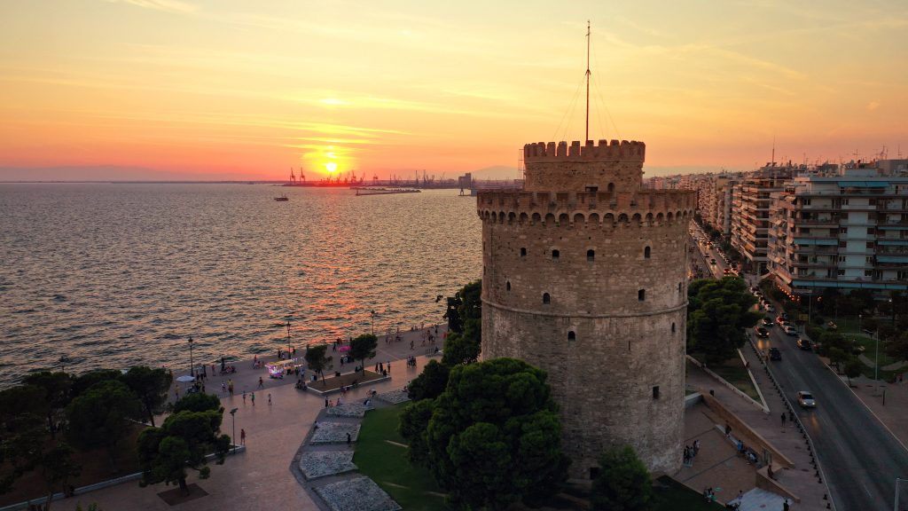

Slide 14
Rotunda & the Arch of Galerius
(or Kamara )
The imposing Rotunda was built by Caesar Galerius in the 4th century to be used as a mausoleum, and two centuries later, Emperor Theodosius turned it into a Christian temple. Kamara (or the Arch of Galerius) is located almost next to Rotunda and portrays representations of Galerius’ victories against the Persians.

Slide 15
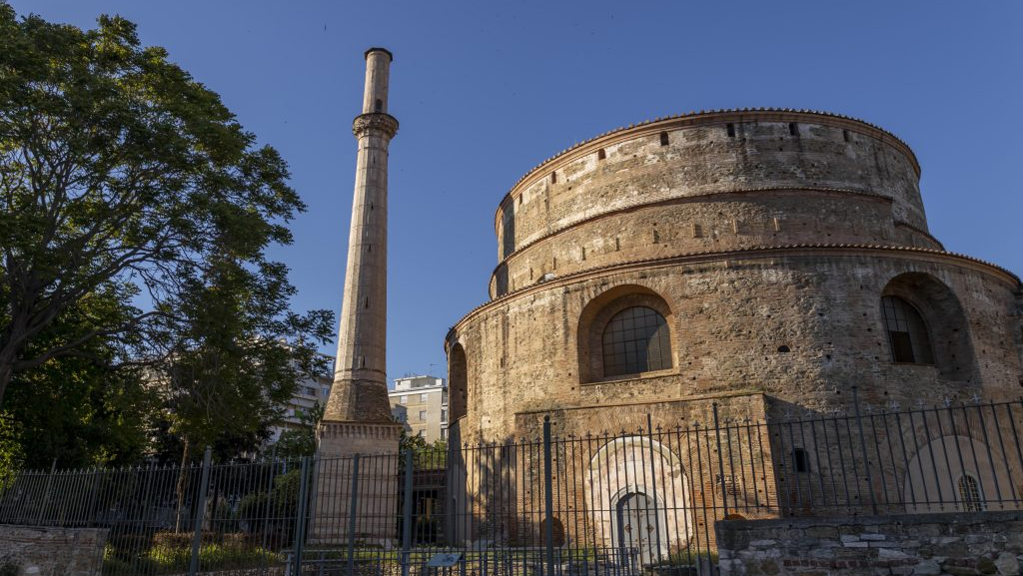

Slide 16
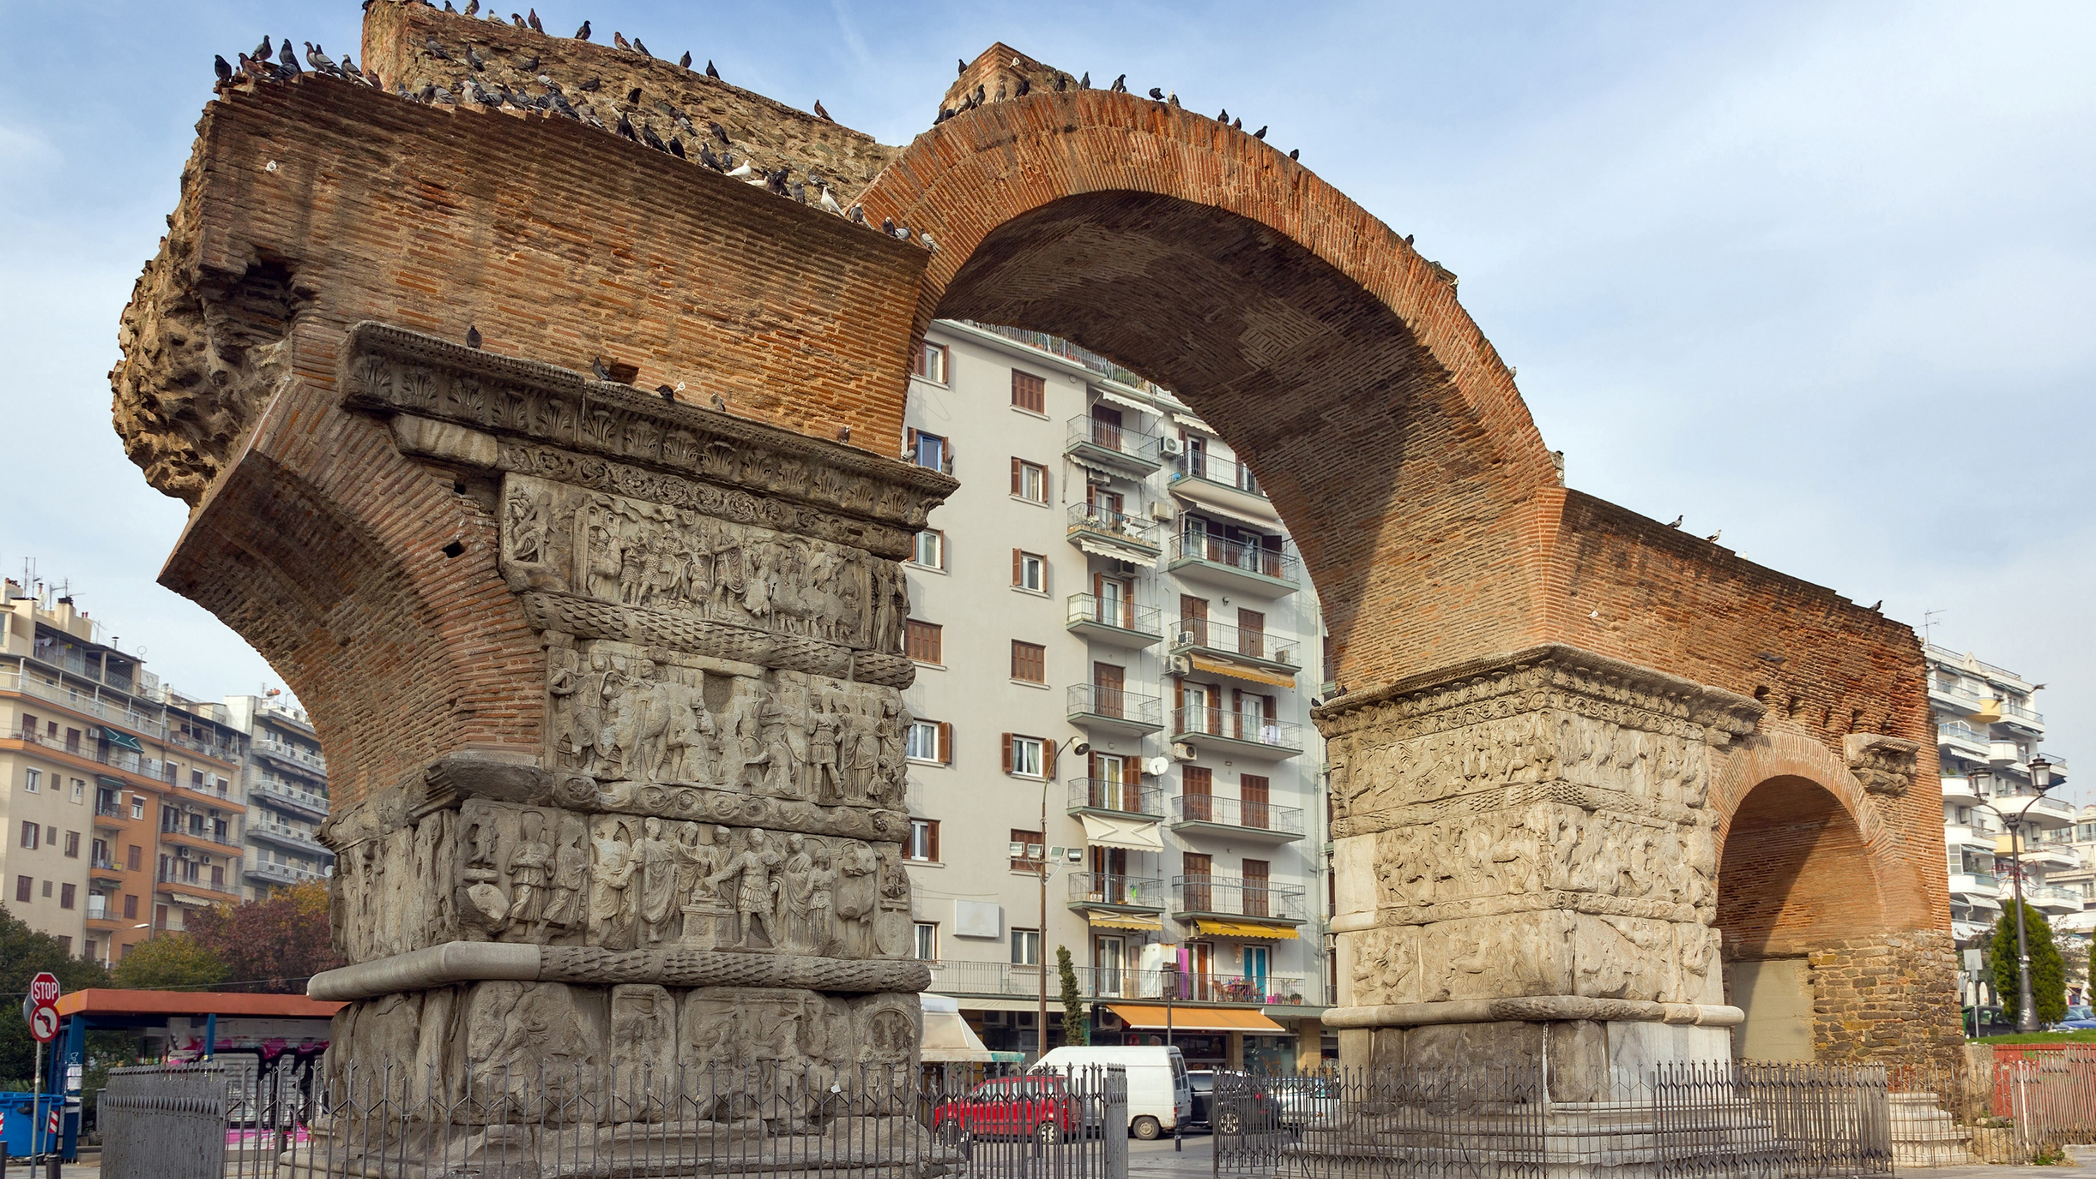

Slide 17
Ancient Agora (or Roman Forum)
The Ancient Agora or Roman Forum was the commercial, social, administrative and religious center of the city. It was built at the end of the 1st century BC and included in its decor arches, fountains, statues and various smaller buildings.

Slide 18
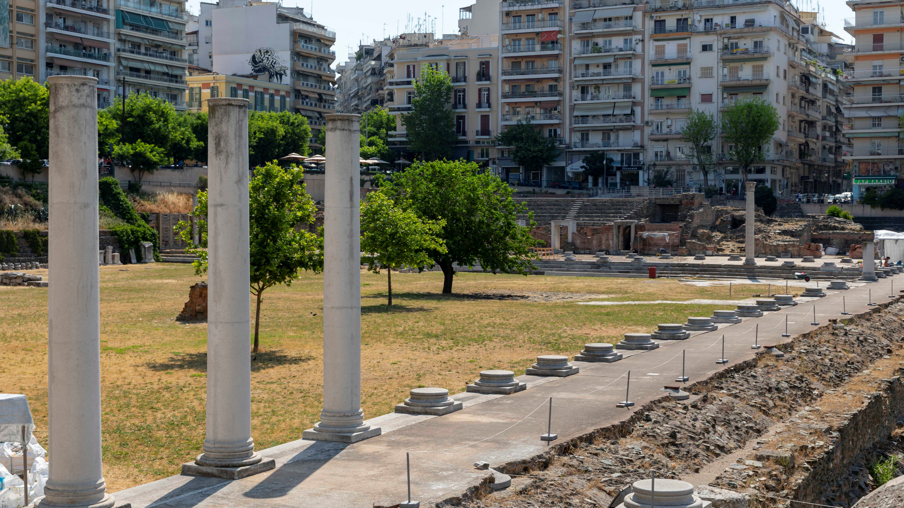

Slide 19
Zeitenlik Cemetery
The Allied Military Cemetery of Zeitenlik is located on Lagadas Street, near Dimokratias Square (Vardaris area). 20,500 soldiers, who fought for the Entente alliance during World War I, have been buried there.

Slide 20
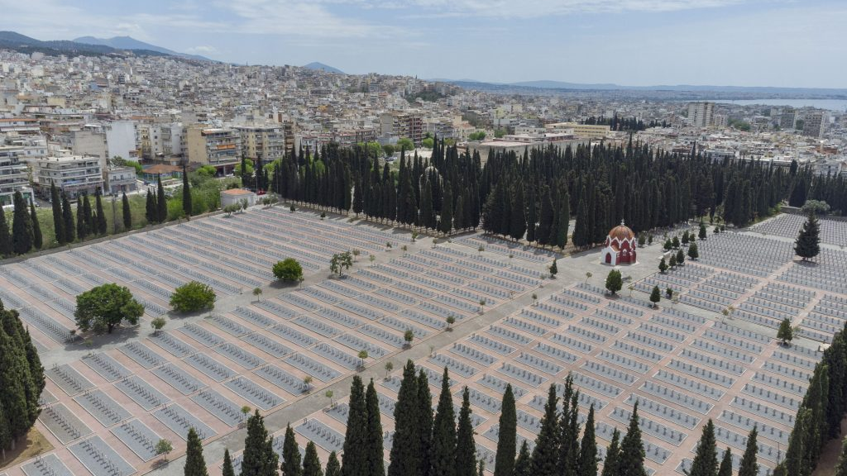

Slide 21
OTTOMAN MONUMENTS OF THE CITY
There are also excellent Ottoman monuments in the city. With the White Tower holding the scepters of glory and Bezesteni, known to the locals as Alkazar and Loutra Paradise, Geni and Yahudi Hamam, Alaca Imaret and so many more.

Slide 22
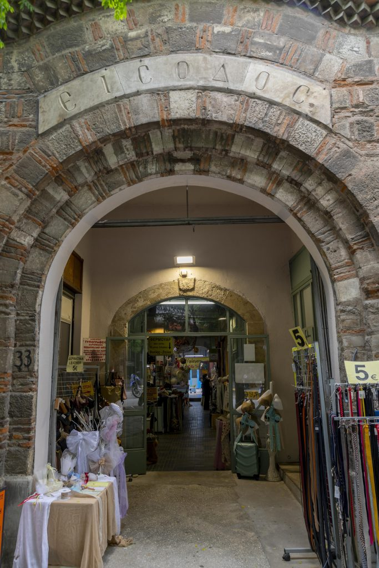
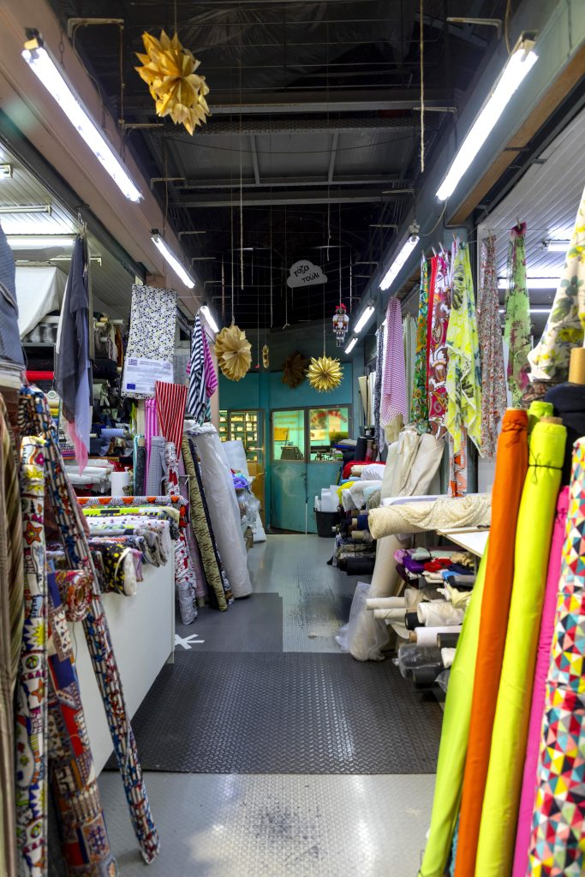

Slide 23
AlaCa Imaret
Built-in 1484, Alaca Imaret is one of the architectural treasures that Thessaloniki inherited from the Ottoman period. An exceptional building, famous in the centuries that followed its foundation for its intellectual work but also its unique aesthetics, took its name from the colored stones used in the construction of the minaret ("alaca" means "colored"). The Alaca Imaret (asylum) institution functioned as a mosque, a poorhouse, and a seminary. In the two largest of the five domes, there was a place of prayer, while the rest, which was connected, provided space for meals and teaching.

Slide 24
