Slide 1



Slide 2
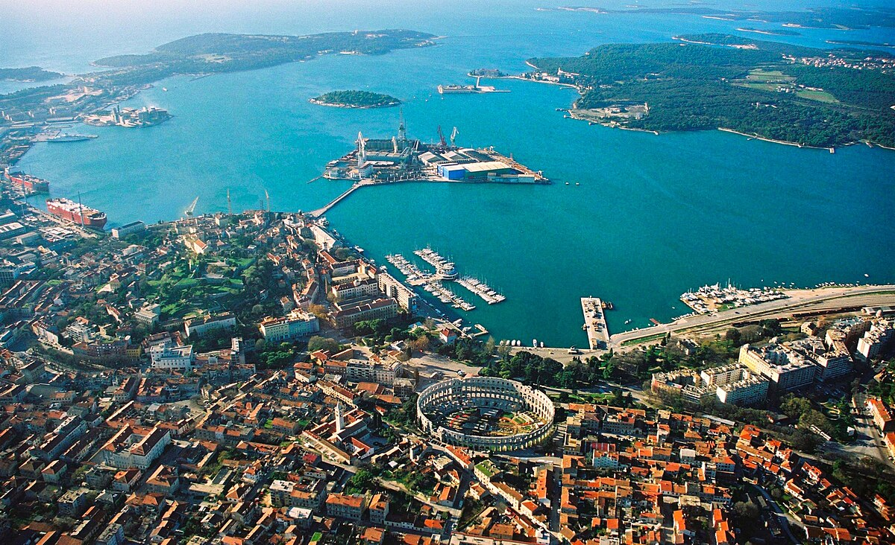
Port of Pula
Made by: Anika Rušin and Mateo Vidakovi

Slide 3
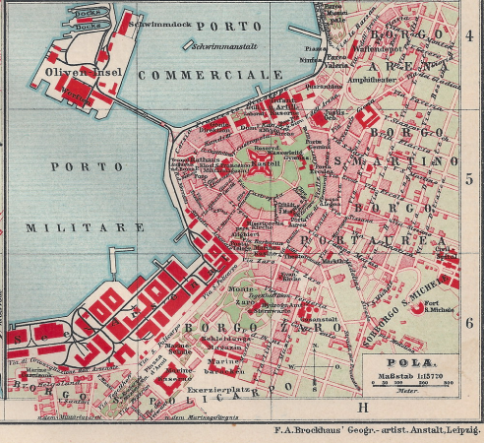
The port of Pula
The port of Pula is located on the southwestern coast of Istria, in the Pula Bay,the port is naturally very well protected from wind and waves
Its geographical location is in the northern Adriatic.
Located in a large and deep bay (Pula Bay) with several smaller bays and islands
Historically, it was the main war port of the Austro-Hungarian Monarchy in the 19th century.
Today it has multiple functions: freight transport, shipyard (Uljanik), passenger and tourist traffic (round trips, yachts), and sports activities.
map of Pula’ s port

Slide 4
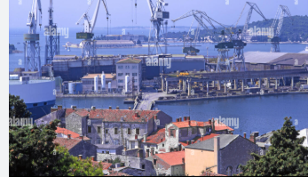
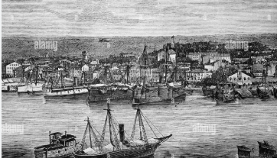
Port of Pula – Past and Present
The first records of the port come from the 1st century, when a Roman colony was founded in that area.
It was the main naval port of the Austrian Empire from 1850 until the collapse of the Austro-Hungarian Empire after World War I.
During this period, the port of Pula experienced greatest rise.
From then until World War II, cargo and passenger port traffic grew continuously.
Pula began to lose it’s position to the competing ports of Rijeka, Trieste and Koper.

Slide 5
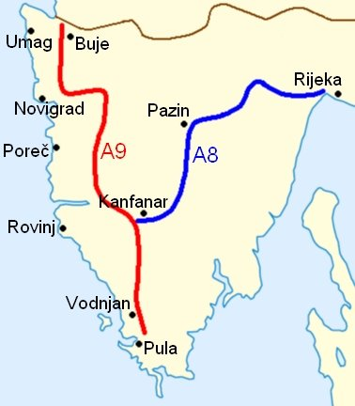
Road and air connections with Pula
Road connections with Pula:
Istria has 2 very important highways:
A8: Rijeka-Kanfanar
A9: Pula-Border with Slovenia
Those two highways pass through almost the whole of Istria
Those highways are called "Istarski ipsilon" (eng."Istrian epsilon")
Air connections with Pula:
Pula Airport is located about 6 km from the city center
It connects Istria with many European destinations, especially in the summer when there is intense tourist traffic (flights to cities in Italy, Austria, Germany, UK)
In Croatia it is connected with Zagreb and other croatian cities.
Istrian epsilon

Slide 6
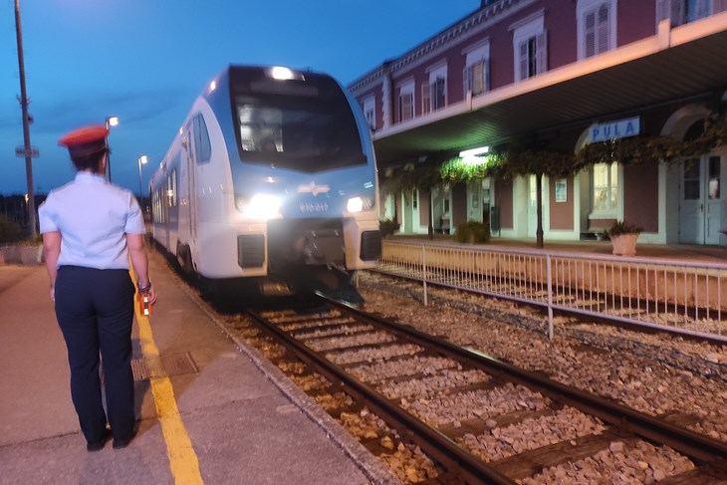
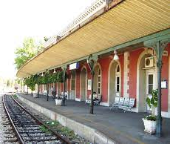
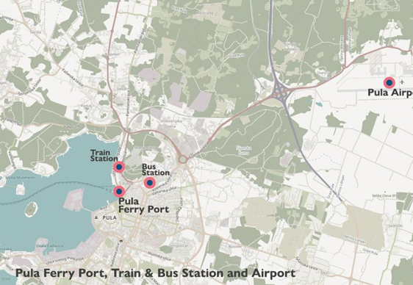

Railway traffic and Connectivity
Pula railway station was built in 1876.
The station functions as a passenger, freight and marshalling station.
In recent years, traffic has decreased.
From the railway station in Pula, an industrial track continues to the Uljanik Shipyard, which also connects the island of Uljanik, the only Croatian island connected to the mainland by rail.

Slide 7
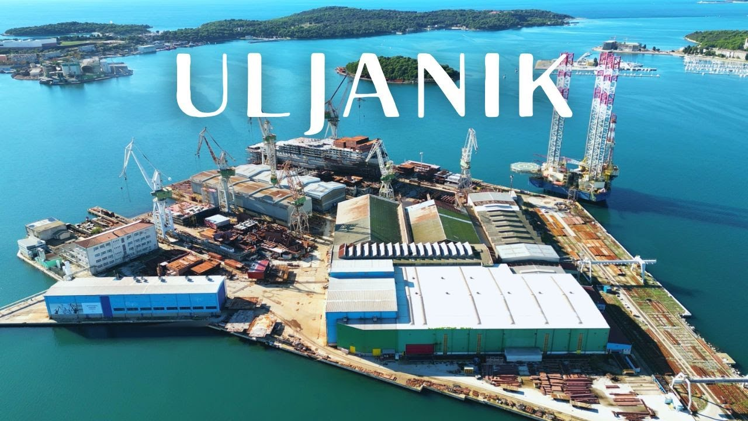
The economic importance of the port
The Uljanik shipyard, located in the port, has been the backbone of Pula's economy for decades
The Port of Pula has a smaller but stable cargo traffic, mainly related to local industries and supplies to Istria
The port is increasingly gaining importance through cruise tourism and nautical tourism (marina, yachts)
The port remains important for employment of the population of Pula (port activities, shipyard, tourism, service industries)
It plays a key role in connecting maritime transport with road and air transport, which strengthens the economy of the wider region

Slide 8
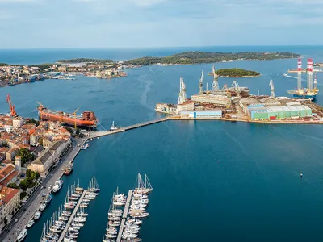
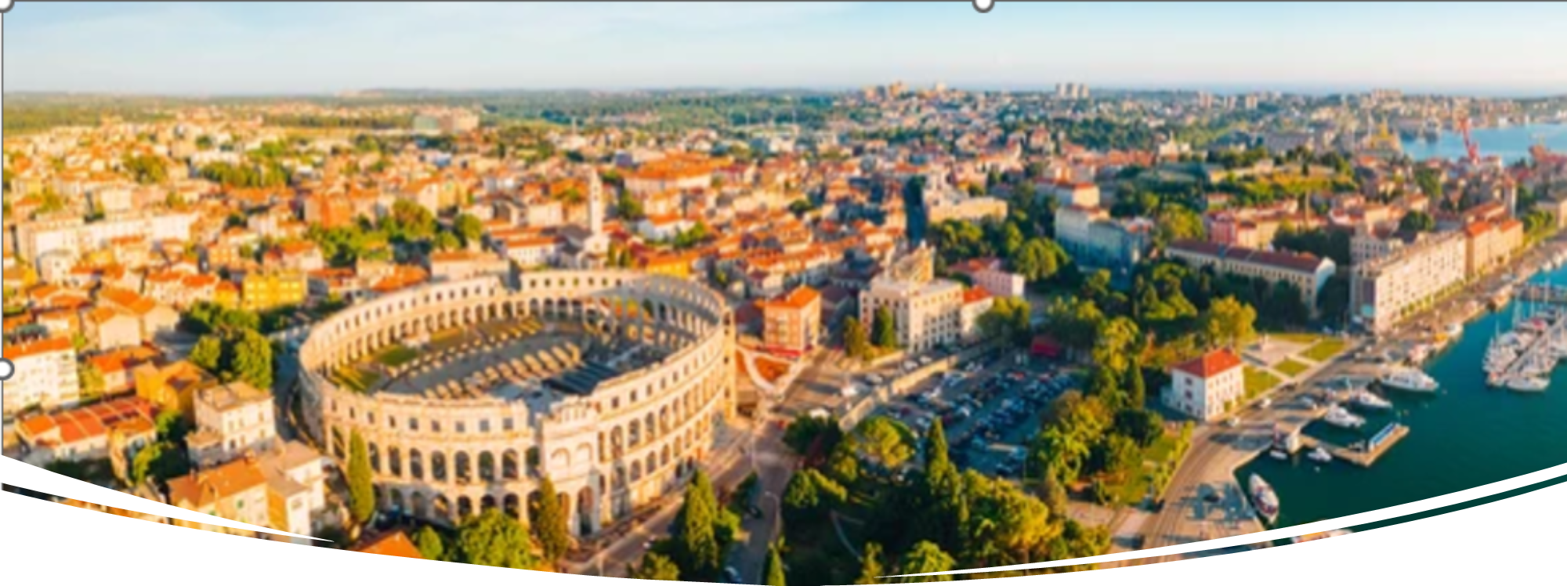
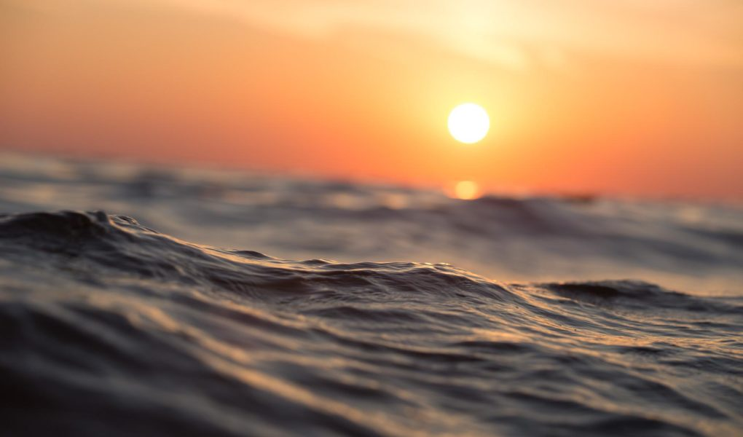
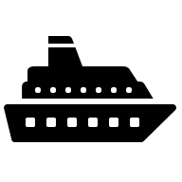

Why is port of Pula important?
The port of Pula is an important port in the northern Adriatic, especially in the summer.
Catamarans go from Pula to Rijeka, Venice, and Trieste.
This is helpful for tourists and other travelers.
These boat lines connect Istria with Italy and the rest of Croatia.
The port also handles cargo but much less than in the past.
Because of its location, it is still important for sea traffic in the region.

Slide 9

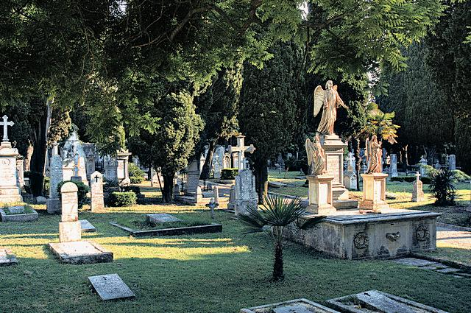
Naval cemetery
It is one of the largest military cemeteries in Europe.
The historic cemetery, founded in 1862, is the final resting place of numerous sailors, officers and military personnel who marked the history of the Austro-Hungarian, Italian and Croatian navies.
Over the centuries, the cemetery has become a symbol of memory, respect and lasting remembrance of those who served at sea.

Slide 10
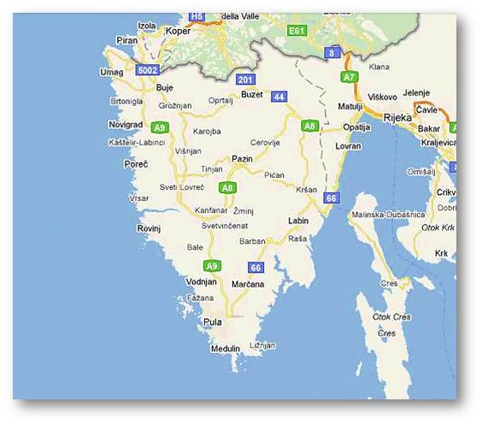
Fun facts
The port of Pula is one of the best naturally protected ports on the Adriatic, with a long military and economic tradition, and today is important for transport, tourism and shipyard
Pula is the largest city in Istria and the cultural, administrative and economic center of the peninsula
The city has a Roman street network (decumanus and cardo), which can still be seen in the old city center today
The port of Pula is considered one of the best naturally protected ports on the Adriatic – it is hidden in a large bay protected by islands and peninsulas
Map of Istria

Slide 11
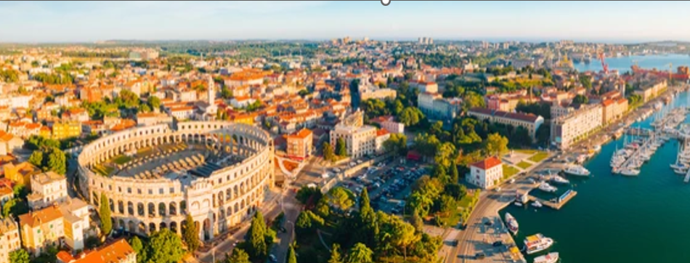
The port of Pula is important because of its location in the northern Adriatic.
Today it plays a major role in passenger traffic, especially during the tourist season.
Although freight traffic is no longer what it used to be, but port still has economic potential.
In the future, it may become even more important for the transport and development of the region.
Conclusion

Slide 12
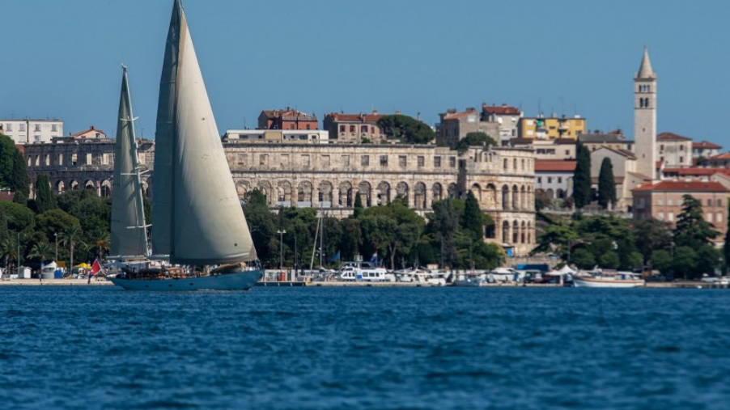
Thank you for your attention!

